Slide 1
Applications of Hierarchal Temporal Memory Algorithm Tools to Energy Demand Analysis
Patrick Barton
Instructor, O’Reilly School of Technology
barton.pj@gmail.com

Slide 2
Overview
Demand forecasting is important, interesting, and not so easy.
NuPIC / Hierarchal Temporal Memory algorithms potentially offer a means to complement existing tools.
Can they be applied to scale up forecasting of micro-level loads to system level ones?

Slide 3
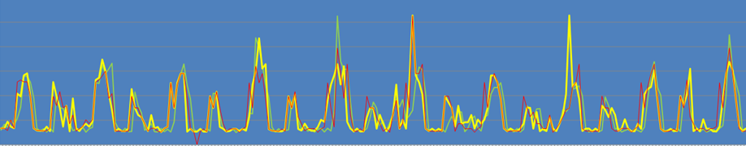
Impetus For This Journey
As an energy scientist and psychometrician, I was intrigued by NuPIC (Numenta) talk @ OSCON, 2013.
If this could be accomplished quickly and cheaply for one building, what else is possible?

Slide 4

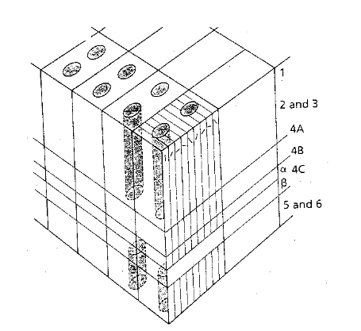
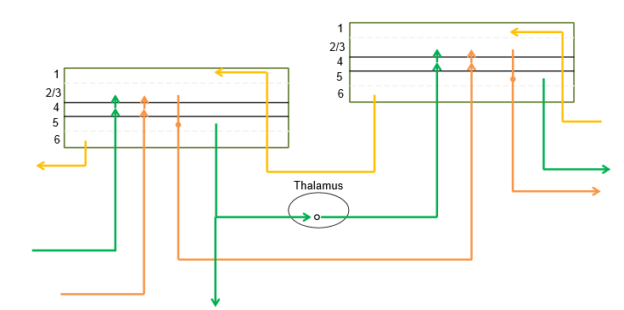
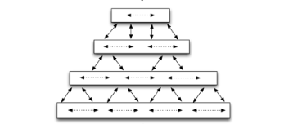
A Very Brief Overview of HTM Algorithms
stack
“cube of stacks”
“wiring diagram”
hierarchy
Source: http://numenta.com/assets/pdf/whitepapers/hierarchical-temporal-memory-cortical-learning-algorithm-0.2.1-en.pdf

Slide 5
A Bit about Electricity
Physical aspects
Regulatory issues
Economic realities around managing in real time ...
... when things can go badly wrong

Slide 6
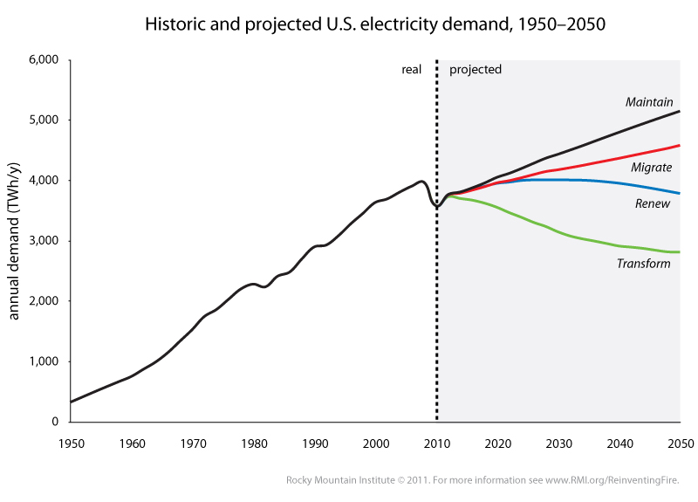
Planning Mistakes == Problems
A vignette on a macro scale:
?
?

Slide 7
Planning Mistakes == Problems
A vignette on a macro scale:
?
?

Slide 8
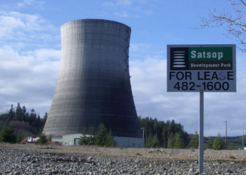
$2 billion+ Later
Whoops! (WPPSS). “A handyman’s special”.
photo: https://ryanjhollander.wordpress.com/2010/02/08/failed-visions-of-a-nuclear-future-the-satsop-power-plant/

Slide 9
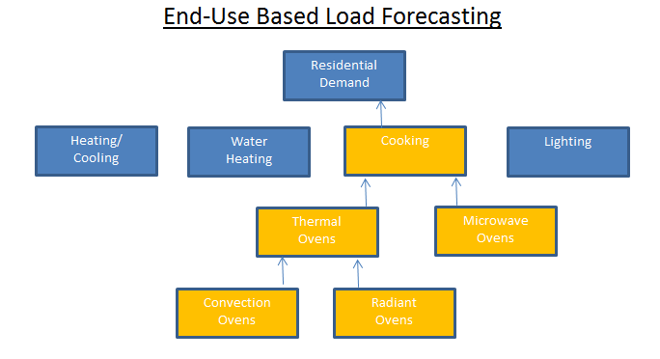
Did We Learn Anything? Yes. Understand Demand
Demand is driven by granular phenomena
... so let’s drill down:
... but that’s got its own issues - data driven, static, engineering based, etc.

Slide 10
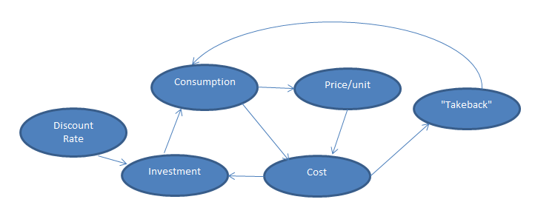
We Can Put a Dynamic Spin on Things
Capturing some inter-temporal interactions:
... but that’s still a rational/engineering model.

Slide 11
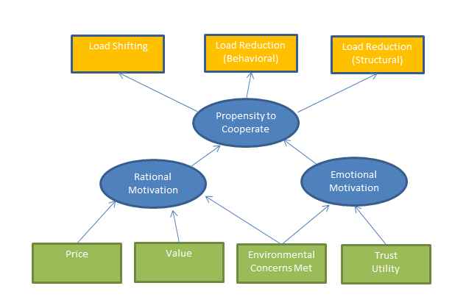
We Can Add a “Psycho Twist”
... which is great to add to the mix, but pretty expensive.

Slide 12
However They’re Done, Good Demand Forecasts are Essential
Spot market pricing – wildly ranging costs
Real time sys op decisions (long term planning can be 1/10 second)
Marginal responsiveness to retail pricing, temperature, etc. = f(structural, systemic behavior, episodic behavior)
... quantification / parameterization can inform “buffering decisions”.

Slide 13
Circling Back to NuPIC
Can HTM insights better inform than human ones?
Is there a je ne sais quoi buried in its pattern recognition?
Can models complement existing tools? (Works for NWS).
There’s only one way to find out. So the journey begins ...

Slide 14
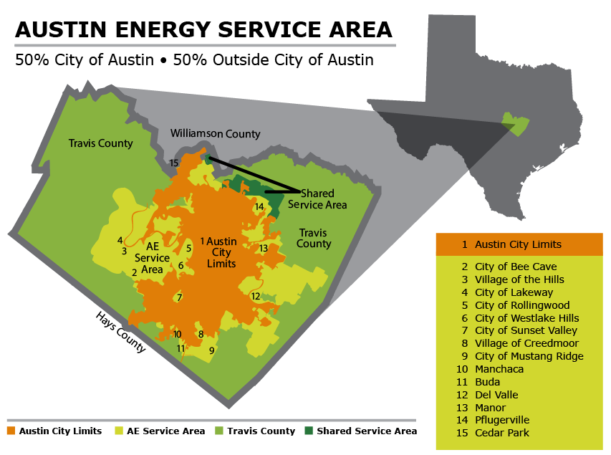
Let’s Try to Extrapolate a Tractable Handful of Intensively-Studied Units
SXSW Austin PUD
..........
..........
..........
..........
..........
We’ll go for similar units in a specific geography and construct a fully-specified simulated service area....
... but first we need data.

Slide 15
Data Acquisition
Surprisingly difficult, but ...
... this amazing organization is dialed in:
http://www.pecanstreet.org

Slide 16
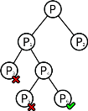
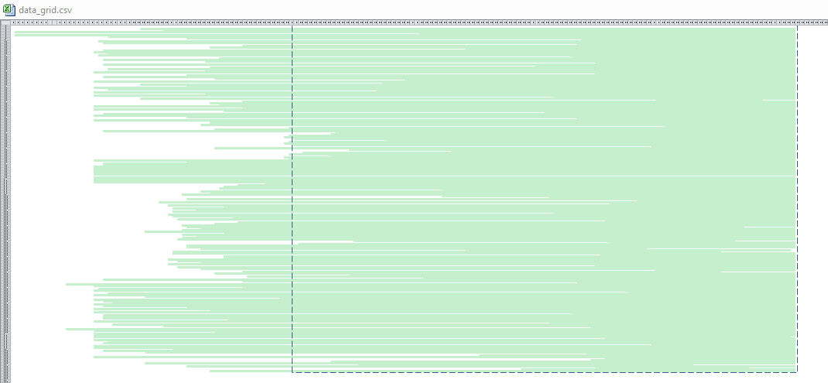
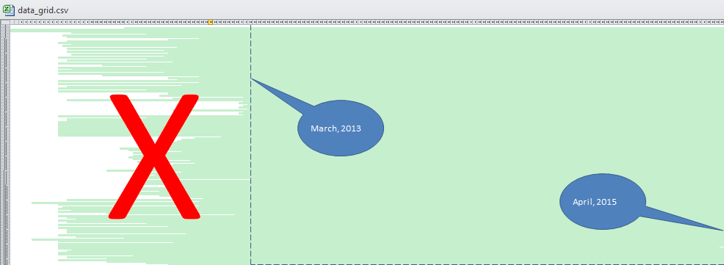
Data Selection
Raw Data – 771 houses from Austin, TX (houses x hours)
Chose 163 houses, ca. 2-year period, minimal missing data.

Slide 17
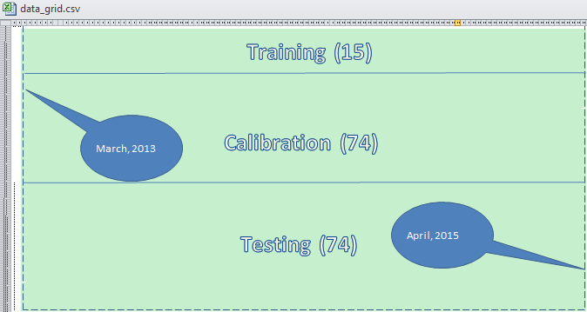
Data Selection (cont.)

Slide 18
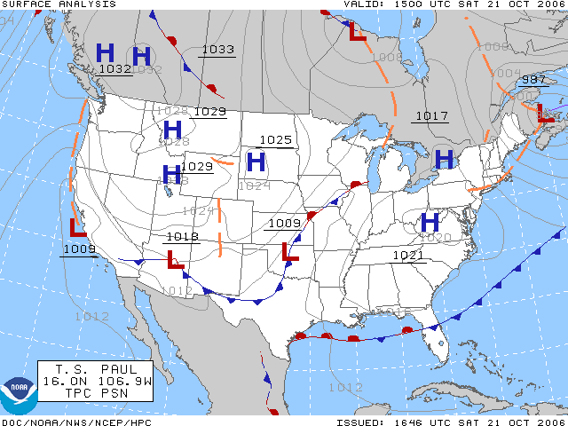

Weather
Austin weather data from the National Weather Service at the Austin-Bergstrin International Airport
http://www7.ncdc.noaa.gov/CDO/cdopoemain.cmd
#"localhour","latitude","longitude","tz_offset","temperature","temperature_error","humidity","humidity_error","wind_speed","cloud_cover"
#"2012-06-10 09:00:00-05",30.292432,-97.699662,-5,77.68,,0.8,,9.19,0.85
TARGET = 72 #target temp in degrees F
WINDOW = 72 #heat buildup window, hours
def build_weights(old_weight=.5, mid_weight=1.0, recent_weight=2.0, window=WINDOW):
'''Let's make up a rule that high temp in the middle of the window contributes to heat buildup,
high temp in the last third contributes twice that, and first third half that'''
weights = [old_weight]*(window//3)
weights.extend([mid_weight] * (window//3))
weights.extend([recent_weight] * (window - len(weights)))
return weights
Heat buildup
Bear in the woods: much better to deal with missing / funky data in the prep stage than to do it in an ad-hoc nature during the input operation to the model optimization and training stages - keeping operations separate makes things much better organized and insular.

Slide 19
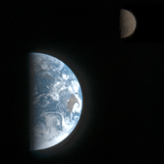
Astronomical Data
Available from US Naval Observatory
Sunrise/sunset data for Austin
Ancillary calculations for:
seconds since sunrise
is_light (1/0)
http://aa.usno.navy.mil/data/docs/RS_OneYear.php

Slide 20

Build/Deploy NuPIC
Plan A: migrate VirtualBox/Ubuntu to EC2 instance. Fail. They only support this with VMWare. "No reason it shouldn't work", though, according to Support.
Plan B: build new NuPIC on EC2 following modern recipes. Fail. Couldn't get Cap'n Proto Python wrapper to install.
Plan C: park VirtualBox images on kid's/spousal unit computers, run 24/7. Fail. Rebellion.
Plan D: install older version of NuPIC on EC2 using requirements.txt from VirtualBox, copy (but don't pip install) intact NuPIC folder. Ugly , but YEA!
Plan D.1: set up a maximally-capable EC2 instance and queue up the swarming/training tasks to run during camping trip. Fail. (Self-inflicted).
Plan D.2: restart maximally-capable instance upon return and get results in a couple days. Fail. Takes hours to run substantive training and/or swarming.
Plan D.3: clone a network of 8-CPU instances, each dedicated to training a single model. A bit tedious but effective.
vCPU | ECU | Memory (GiB) | Instance Storage (GB) | Linux/UNIX Usage
c3.2xlarge | 8 | 28 | 15 | 2 x 80 SSD | $0.42 per Hour

Slide 21

Help for Others
Bear in the woods: NuPIC is not particularly easy to get going, at least from my experience.
Here's my local requirements.txt. Best to run with --no-dependencies:
Working version of nupic (sans wxagg)
(nupic)pat@pat-VirtualBox:~/workspace/nupic$ cat requirements.txt
Bottleneck==0.8.0
DBUtils==1.1
Pillow==2.3.0
PyMySQL==0.6.2
PyYAML==3.10
argparse==1.2.1
asteval==0.9.1
astroid==1.3.2
backports.ssl-match-hostname==3.4.0.2
certifi==14.05.14
cov-core==1.15.0
coverage==3.7.1
execnet==1.2.0
ipython==0.13.2
logilab-common==0.63.0
matplotlib==1.3.1
mock==1.0.1
nose==1.3.4
numexpr==2.4
numpy==1.7.1
-e git+https://github.com/numenta/nupic.git@f757abf953146d4d4d42dfa487d463c7abacbca0#egg=nupic-master
The good news: I'll have a clean EC2 image available in a couple weeks ...
...for anyone who wants.
ordereddict==1.1
pandas==0.15.1
prettytable==0.7.2
psutil==1.0.1
py==1.4.26
pylint==1.1.0
pyparsing==2.0.3
pyproj==1.9.3
pytest==2.4.2
pytest-cov==1.6
pytest-xdist==1.8
python-dateutil==2.1
pytz==2014.9
pyzmq==14.4.1
six==1.8.0
tornado==4.0.2
tweepy==2.1
unittest2==0.5.1
validictory==0.9.1
wsgiref==0.1.2

Slide 22
Model Specification
For each training house, I specified three operational modes: energy only, straight weather data, and weather data supplemented by daylight and heat buildup observations.
modes={
'energy_only' : [timestamp, euse],
'weather' : [timestamp, euse, temp, humid, wind],
'weather_plus': [timestamp, euse, temp, humid, wind, is_daylight, buildup, sec_since_rise]
}

Slide 23
Model Optimization
Used NuPIC’s built in “swarming”
SWARM_DESCTIPTION = {'includedFields': [{'fieldName': 'timestamp', 'fieldType': 'datetime'},
{'fieldName': 'euse',
'fieldType': 'float',
'maxValue': 35.0,
'minValue': 10.0}],
'inferenceArgs': {'predictedField': 'euse', 'predictionSteps': [40]},
'inferenceType': 'TemporalMultiStep',
'iterationCount': -1,
'streamDef': {'info': 'kwh',
'streams': [{'columns': ['timestamp', 'euse'],
'info': 'energy_only_624',
'source': 'file:///mnt/pecan/house_data/624_data/624_clean_data.csv'}]},
'swarmSize': 'medium'}
... through a hierarchal directory structure (makes automation/production much easier/saner).
Can be done manually

Slide 24
... which produces a parameterized starting point
MODEL_PARAMS = {'aggregationInfo': {'days': 0,
'fields': [],
'hours': 0,
'microseconds': 0,
'milliseconds': 0,
'minutes': 0,
'months': 0,
'seconds': 0,
'weeks': 0,
'years': 0},
'model': 'CLA',
'modelParams': {'anomalyParams': {u'anomalyCacheRecords': None,
u'autoDetectThreshold': None,
u'autoDetectWaitRecords': None},
'clParams': {'alpha': 0.050050000000000004,
'clVerbosity': 0,
'regionName': 'CLAClassifierRegion',
'steps': '40'},
'inferenceType': 'TemporalMultiStep',
'sensorParams': {'encoders': {'_classifierInput': {'classifierOnly': True,
'clipInput': True,
'fieldname': 'euse',
'maxval': 35.0,
'minval': 10.0,
'n': 275,
'name': '_classifierInput',
'type': 'ScalarEncoder',
'w': 21},
u'buildup': {'clipInput': True,
'fieldname': 'buildup',
'maxval': 100.0,
'minval': -100.0,
'n': 272,
'name': 'buildup',
'type': 'ScalarEncoder',
'w': 21},
u'euse': None,
u'humid': None,
u'is_daylight': None,
u'sec_since_rise': None,
u'temp': None,
u'timestamp_dayOfWeek': None,
u'timestamp_timeOfDay': None,
u'timestamp_weekend': None,
u'wind': None},
'sensorAutoReset': None,
'verbosity': 0},
'spEnable': True,
'spParams': {'columnCount': 2048,
'globalInhibition': 1,
'inputWidth': 0,
'maxBoost': 2.0,
'numActiveColumnsPerInhArea': 40,
'potentialPct': 0.8,
'seed': 1956,
'spVerbosity': 0,
'spatialImp': 'cpp',
'synPermActiveInc': 0.05,
'synPermConnected': 0.1,
'synPermInactiveDec': 0.05015},
'tpEnable': True,
'tpParams': {'activationThreshold': 14,
'cellsPerColumn': 32,
'columnCount': 2048,
'globalDecay': 0.0,
'initialPerm': 0.21,
'inputWidth': 2048,
'maxAge': 0,
'maxSegmentsPerCell': 128,
'maxSynapsesPerSegment': 32,
'minThreshold': 11,
'newSynapseCount': 20,
'outputType': 'normal',
'pamLength': 3,
'permanenceDec': 0.1,
'permanenceInc': 0.1,
'seed': 1960,
'temporalImp': 'cpp',
'verbosity': 0},
'trainSPNetOnlyIfRequested': False},
'predictAheadTime': None,
'version': 1}

Slide 25

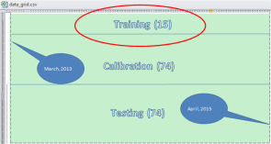
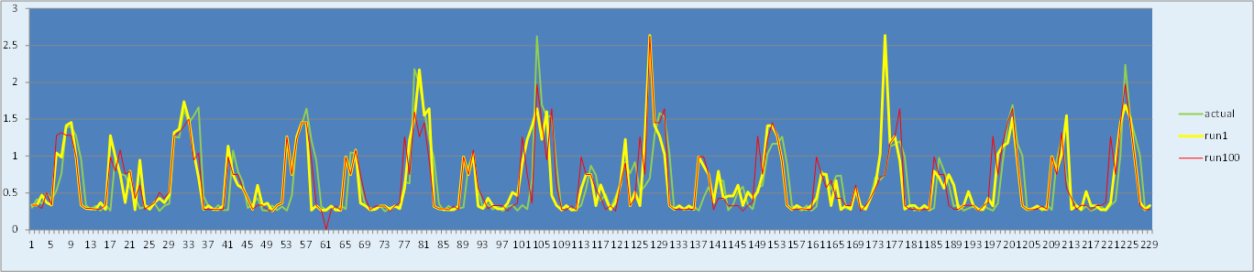
Training
How much learning should be provided?
From a certain perspective the answer is "the more, the better".
From another, the answer is "...but you don't want to train them to the point where they can only predict the past.“
These things do learn over time, as can be demonstrated. Here's a house from San Diego (different data source) and the results of training up to 100 iterations.
Performance is not as I expected as I attempted real production. Adding information e.g., weather, heat buildup, etc. had a substantial effect on performance/throughput

Slide 26
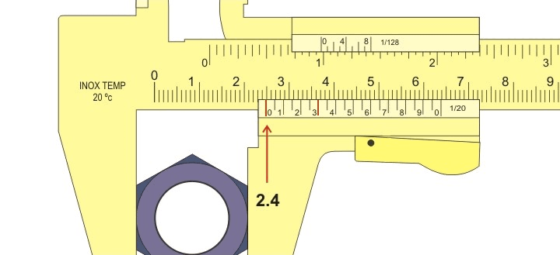
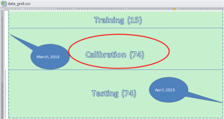
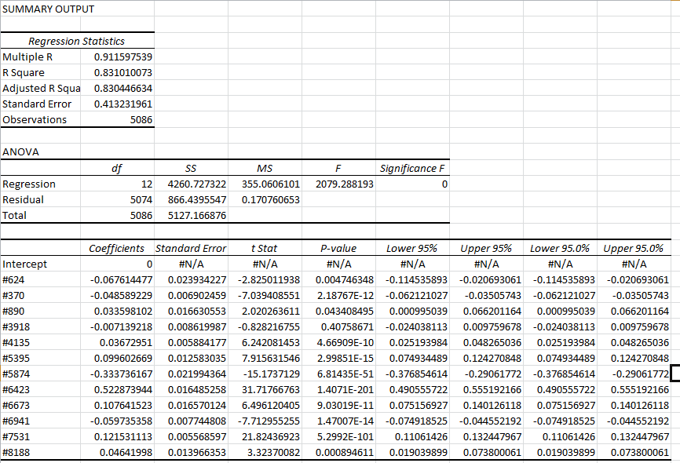

Calibration
Loads
Weights
Assigned weights to each trained model via OLS multiple linear regression. Best fit of (training loads * training weights) to observed loads.

Slide 27
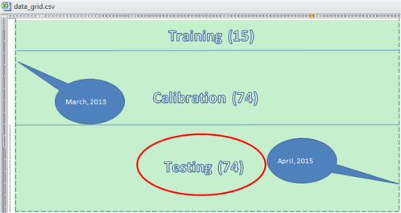

Testing Against “Naive” Data
Does the weighted average of the models trained against individual houses accurately predict the average load or the “other half” of the data?
And the results are ...

Slide 28
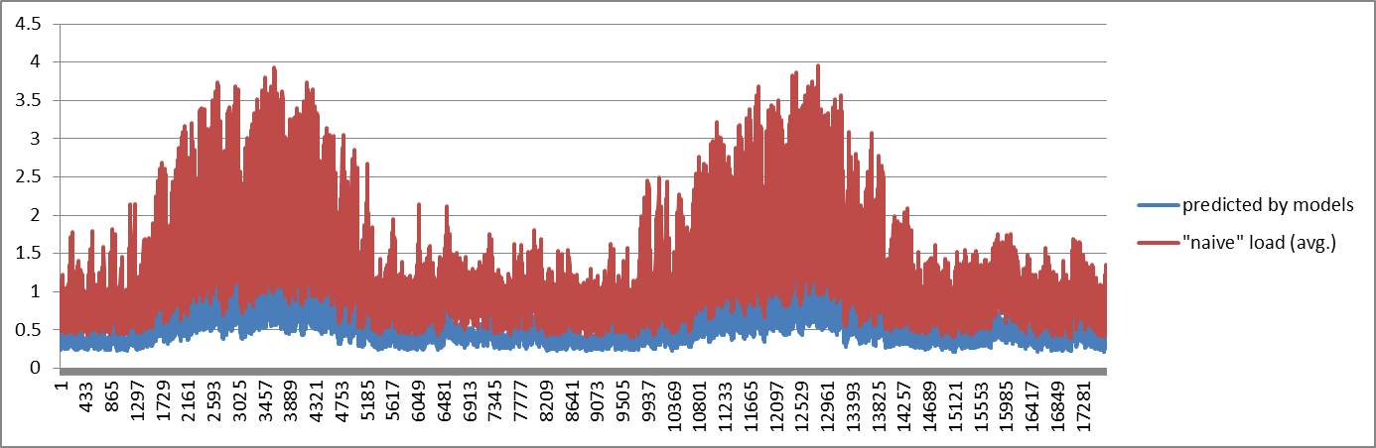
Uncertain, But Not Promising
... but it might just be a matter of scaling?

Slide 29
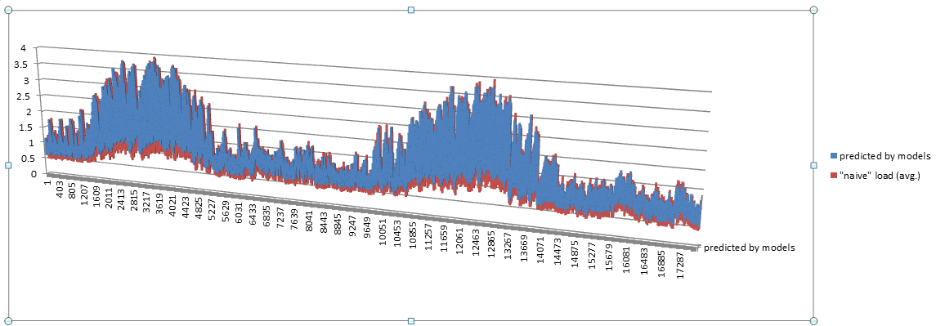
Scaling Predicted Loads by 2.5 Yields:
... which is much closer to what I had in mind – not quite sure it worked as expected. But that’s OK. It’s a work in progress ...

Slide 30

... and as they say in Chicago:

Slide 31
See you next year. Thank You!
Patrick Barton
barton.pj@gmail.com
... and Go Cubs!

